Slide 1
Optimization Methods-2
Lecture 2

Slide 2
III. What is a Metaheruistic Method?
Meta : in an upper level
Heuristic : to find
A metaheuristic is formally defined as an iterative generation process which guides a subordinate heuristic by combining intelligently different concepts for exploring and exploiting the search space, learning strategies are used to structure information in order to find efficiently near-optimal solutions. [Osman and Laporte 1996].

Slide 3
Fundamental Properties of Metaheuristics [Blum and Roli 2003]
Metaheuristics are strategies that “guide” the search process.
The goal is to efficiently explore the search space in order to find (near-)optimal solutions.
Techniques which constitute metaheuristic algorithms range from simple local search procedures to complex learning processes.
Metaheuristic algorithms are approximate and usually non-deterministic.

Slide 4
Fundamental Properties of Metaheuristics (cont.)
They may incorporate mechanisms to avoid getting trapped in confined areas of the search space.
The basic concepts of metaheuristics permit an abstract level description.
Metaheuristics are not problem-specific.
Metaheuristics may make use of domain-specific knowledge in the form of heuristics that are controlled by the upper level strategy.
Today’s more advanced metaheuristics use search experience (embodied in some form of memory) to guide the search.

Slide 5
Genetic Algorithms (GA) Quick Overview
Developed: USA in the 1970’s
Early names: J. Holland, K. DeJong, D. Goldberg
Typically applied to:
discrete optimization
Attributed features:
not too fast
good heuristic for combinatorial problems
Special Features:
Traditionally emphasizes combining information from good parents (crossover)
many variants, e.g., reproduction models, operators

Slide 6
Genetic algorithms
Holland’s original GA is now known as the simple genetic algorithm (SGA)
Other GAs use different:
Representations
Mutations
Crossovers
Selection mechanisms

Slide 7
SGA technical summary tableau
Representation | Binary strings
Recombination | N-point or uniform
Mutation | Bitwise bit-flipping with fixed probability
Parent selection | Fitness-Proportionate
Survivor selection | All children replace parents
Speciality | Emphasis on crossover

Slide 8
Representation
Phenotype space
Genotype space = {0,1}^{L}
Encoding
(representation)
10010001
10010010
010001001
011101001
Decoding
(inverse representation)

Slide 9
The Metaphor
Nature | Genetic Algorithm
Environment | Optimization problem
Individuals living in that environment | Feasible solutions
Individual’s degree of adaptation to its surrounding environment | Solutions quality (fitness function)

Slide 10
The Metaphor (cont)
Nature | Genetic Algorithm
A population of organisms (species) | A set of feasible solutions
Selection, recombination and mutation in nature’s evolutionary process | Stochastic operators
Evolution of populations to suit their environment | Iteratively applying a set of stochastic operators on a set of feasible solutions

Slide 11
The Metaphor (cont)
The computer model introduces simplifications (relative to the real biological mechanisms),
BUT
surprisingly complex and interesting structures have emerged out of evolutionary algorithms

Slide 12
SGA reproduction cycle
Select parents for the mating pool
(size of mating pool = population size)
Shuffle the mating pool
For each consecutive pair apply crossover with probability p_{c} , otherwise copy parents
For each offspring apply mutation (bit-flip with probability p_{m} independently for each bit)
Replace the whole population with the resulting offspring

Slide 13
The Evolutionary Cycle
parents
selection
modification
modified
offspring
initiate &
population
evaluation
evaluate
evaluated offspring
deleted
members
discard

Slide 14
Genetic Algorithm (GA)
GA
— Individuals
next generation, replace all idv,
do it again and again
pick the best
idv to use
Fitness Function
Genetic Operator
generation
random
new
generation
bad idv

Slide 15
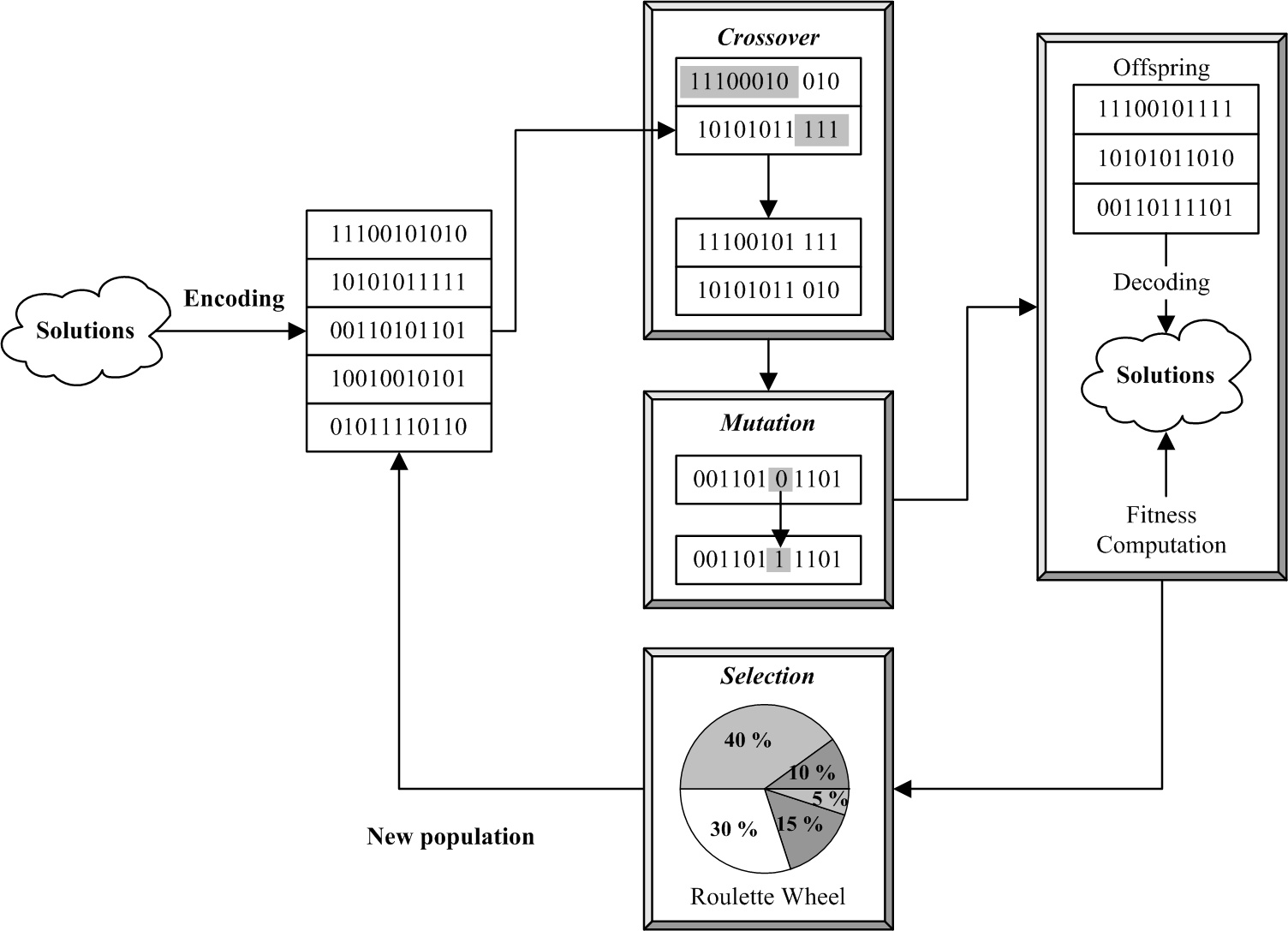

Slide 16
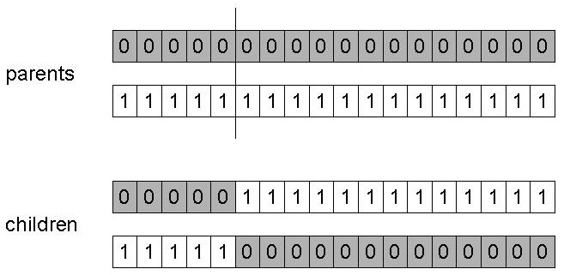
SGA operators: 1-point crossover
Choose a random point on the two parents
Split parents at this crossover point
Create children by exchanging tails
P_{c} typically in range (0.6, 0.9)

Slide 17
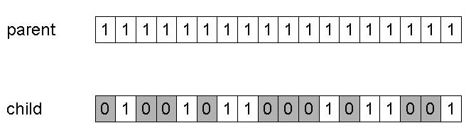
SGA operators: mutation
Alter each gene independently with a probability p_{m}
p_{m} is called the mutation rate
Typically between 1/pop_size and 1/ chromosome_length

Slide 18
SGA operators: Selection
Main idea: better individuals get higher chance
Chances proportional to fitness
Implementation: roulette wheel technique
Assign to each individual a part of the roulette wheel
Spin the wheel n times to select n individuals
1/6 = 17%
B
fitness(A) = 3
A
C
fitness(B) = 1
3/6 = 50%
2/6 = 33%
fitness(C) = 2

Slide 19
An example after Goldberg ‘89 (1)
Simple problem: max x² over {0,1,…,31}
GA approach:
Representation: binary code, e.g. 01101 ↔ 13
Population size: 4
1-point xover, bitwise mutation
Roulette wheel selection
Random initialisation
We show one generational cycle done by hand

Slide 20
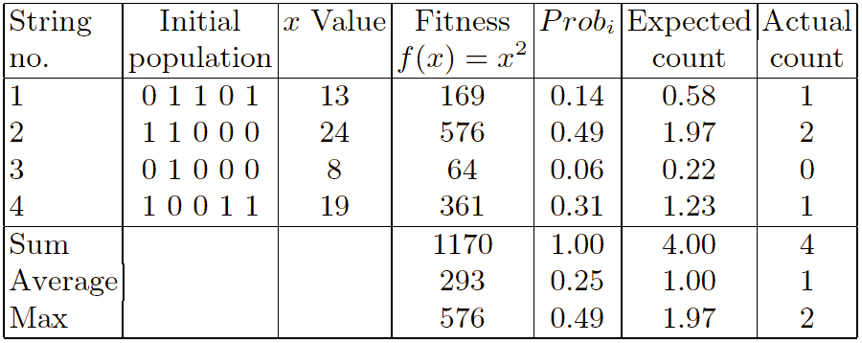
x2 example: selection

Slide 21
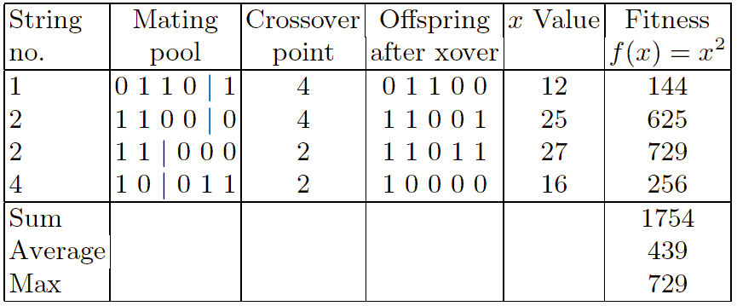
X2 example: crossover

Slide 22
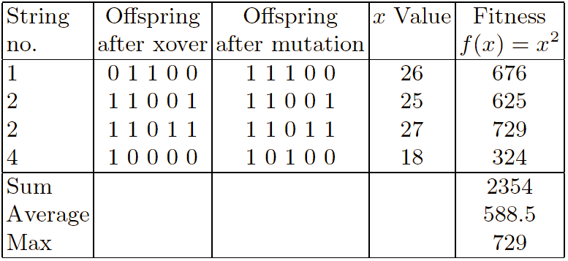
X² example: mutation

Slide 23
The simple GA
Has been subject of many (early) studies
still often used as benchmark for novel GAs
Shows many shortcomings, e.g.
Representation is too restrictive
Mutation & crossovers only applicable for bit-string & integer representations
Selection mechanism sensitive for converging populations with close fitness values
Generational population model (step 5 in SGA repr. cycle) can be improved with explicit survivor selection

Slide 24
Alternative Crossover Operators
Performance with 1 Point Crossover depends on the order that variables occur in the representation
more likely to keep together genes that are near each other
Can never keep together genes from opposite ends of string
This is known as Positional Bias
Can be exploited if we know about the structure of our problem, but this is not usually the case

Slide 25
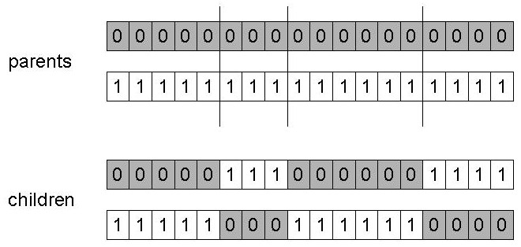
n-point crossover
Choose n random crossover points
Split along those points
Glue parts, alternating between parents
Generalisation of 1 point (still some positional bias)

Slide 26
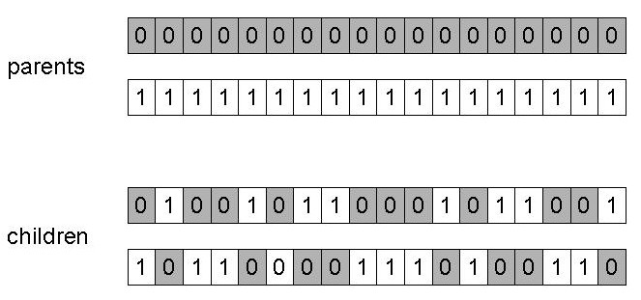
Uniform crossover
Assign 'heads' to one parent, 'tails' to the other
Flip a coin for each gene of the first child
Make an inverse copy of the gene for the second child
Inheritance is independent of position

Slide 27
Crossover OR mutation?
Decade long debate: which one is better / necessary / main-background
Answer (at least, rather wide agreement):
it depends on the problem, but
in general, it is good to have both
both have another role
mutation-only-EA is possible, xover-only-EA would not work

Slide 28
Crossover OR mutation? (cont’d)
Exploration: Discovering promising areas in the search space, i.e. gaining information on the problem
Exploitation: Optimising within a promising area, i.e. using information
There is co-operation AND competition between them
Crossover is explorative, it makes a big jump to an area somewhere “in between” two (parent) areas
Mutation is exploitative, it creates random small diversions, thereby staying near (in the area of ) the parent

Slide 29
Crossover OR mutation? (cont’d)
Only crossover can combine information from two parents
Only mutation can introduce new information (alleles)
Crossover does not change the allele frequencies of the population (thought experiment: 50% 0’s on first bit in the population, ?% after performing n crossovers)
To hit the optimum you often need a ‘lucky’ mutation

Slide 30
Other representations
Gray coding of integers (still binary chromosomes)
Gray coding is a mapping that means that small changes in the genotype cause small changes in the phenotype (unlike binary coding). “Smoother” genotype-phenotype mapping makes life easier for the GA
Nowadays it is generally accepted that it is better to encode numerical variables directly as
Integers
Floating point variables

Slide 31
Integer representations
Some problems naturally have integer variables, e.g. image processing parameters
Others take categorical values from a fixed set e.g. {blue, green, yellow, pink}
N-point / uniform crossover operators work
Extend bit-flipping mutation to make
“creep” i.e. more likely to move to similar value
Random choice (esp. categorical variables)
For ordinal problems, it is hard to know correct range for creep, so often use two mutation operators in tandem

Slide 32
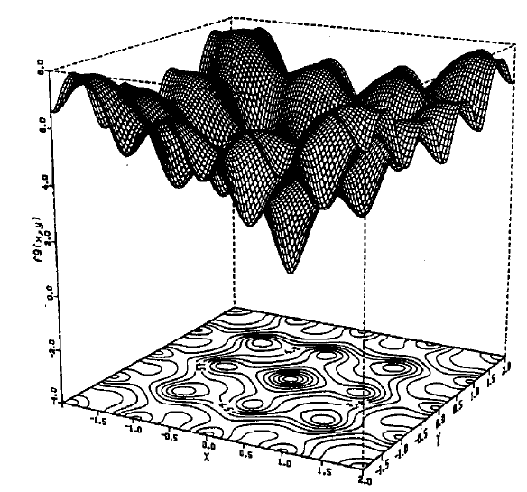
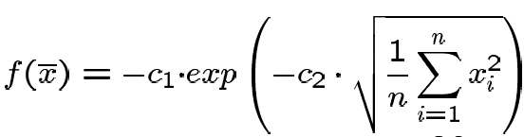

Real valued problems
Many problems occur as real valued problems, e.g. continuous parameter optimisation f : ℜ ^{n} → ℜ
Illustration: Ackley’s function (often used in EC)

Slide 33
Mapping real values on bit strings
z ∈ [x,y] ⊆ ℜ represented by {a₁,…,a_{L}} ∈ {0,1}^{L}
[x,y] → {0,1}^{L} must be invertible (one phenotype per genotype)
Γ: {0,1}^{L} → [x,y] defines the representation
Only 2^{L} values out of infinite are represented
L determines possible maximum precision of solution
High precision → long chromosomes (slow evolution)

Slide 34
Floating point mutations 1
General scheme of floating point mutations
Uniform mutation:
Analogous to bit-flipping (binary) or random resetting (integers)

Slide 35
Floating point mutations 2
Non-uniform mutations:
Many methods proposed,such as time-varying range of change etc.
Most schemes are probabilistic but usually only make a small change to value
Most common method is to add random deviate to each variable separately, taken from N(0, σ) Gaussian distribution and then curtail to range
Standard deviation σ controls amount of change (2/3 of deviations will lie in range (- σ to + σ)

Slide 36
Crossover operators for real valued GAs
Discrete:
each allele value in offspring z comes from one of its parents (x,y) with equal probability: z_{i} = x_{i} or y_{i}
Could use n-point or uniform
Intermediate
exploits idea of creating children “between” parents (hence a.k.a. arithmetic recombination)
z_{i} = α x_{i} + (1 - α) y_{i} where α : 0 ≤ α ≤ 1.
The parameter α can be:
constant: uniform arithmetical crossover
variable (e.g. depend on the age of the population)
picked at random every time

Slide 37
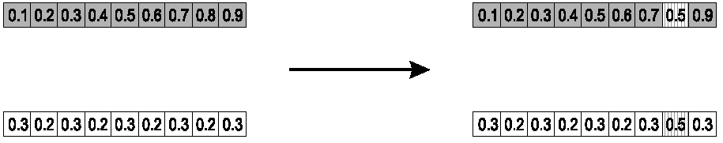
Single arithmetic crossover
Parents: ⟨x₁,…,x_{n} ⟩ and ⟨y₁,…,y_{n}⟩
Pick a single gene (k) at random,
child₁ is:
reverse for other child. e.g. with α = 0.5

Slide 38
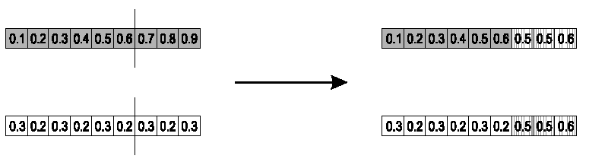
Simple arithmetic crossover
Parents: ⟨x₁,…,x_{n} ⟩ and ⟨y₁,…,y_{n}⟩
Pick random gene (k) after this point mix values
child₁ is:
reverse for other child. e.g. with α = 0.5

Slide 39
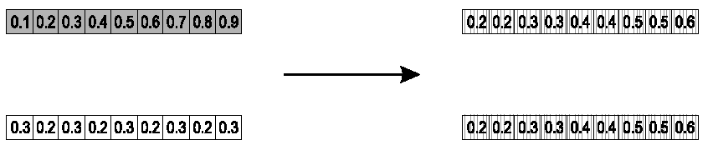
Whole arithmetic crossover
Most commonly used
Parents: ⟨x₁,…,x_{n} ⟩ and ⟨y₁,…,y_{n}⟩
child₁ is:
reverse for other child. e.g. with α = 0.5

Slide 40
Permutation Representations
Ordering/sequencing problems form a special type
Task is (or can be solved by) arranging some objects in a certain order
Example: sort algorithm: important thing is which elements occur before others (order)
Example: Travelling Salesman Problem (TSP) : important thing is which elements occur next to each other (adjacency)
These problems are generally expressed as a permutation:
if there are n variables then the representation is as a list of n integers, each of which occurs exactly once

Slide 41
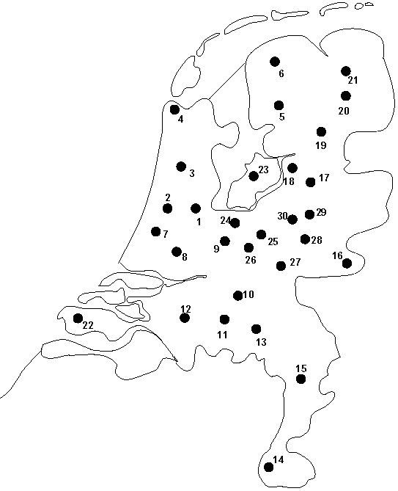
Permutation representation: TSP example
Problem:
Given n cities
Find a complete tour with minimal length
Encoding:
Label the cities 1, 2, … , n
One complete tour is one permutation (e.g. for n =4 [1,2,3,4], [3,4,2,1] are OK)
Search space is BIG:
for 30 cities there are 30! ≈ 10³² possible tours

Slide 42
Mutation operators for permutations
Normal mutation operators lead to inadmissible solutions
e.g. bit-wise mutation : let gene i have value j
changing to some other value k would mean that k occurred twice and j no longer occurred
Therefore must change at least two values
Mutation parameter now reflects the probability that some operator is applied once to the whole string, rather than individually in each position

Slide 43
Insert Mutation for permutations
Pick two allele values at random
Move the second to follow the first, shifting the rest along to accommodate
Note that this preserves most of the order and the adjacency information

Slide 44
Swap mutation for permutations
Pick two alleles at random and swap their positions
Preserves most of adjacency information (4 links broken), disrupts order more

Slide 45
Inversion mutation for permutations
Pick two alleles at random and then invert the substring between them.
Preserves most adjacency information (only breaks two links) but disruptive of order information

Slide 46
Scramble mutation for permutations
Pick a subset of genes at random
Randomly rearrange the alleles in those positions
(note subset does not have to be contiguous)

Slide 47
Crossover operators for permutations
“Normal” crossover operators will often lead to inadmissible solutions
Many specialised operators have been devised which focus on combining order or adjacency information from the two parents
1 2 3 4 5
1 2 3 2 1
5 4 3 2 1
5 4 3 4 5

Slide 48
Order 1 crossover
Idea is to preserve relative order that elements occur
Informal procedure:
1. Choose an arbitrary part from the first parent
2. Copy this part to the first child
3. Copy the numbers that are not in the first part, to the first child:
starting right from cut point of the copied part,
using the order of the second parent
and wrapping around at the end
4. Analogous for the second child, with parent roles reversed

Slide 49
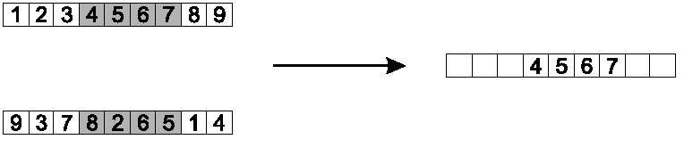
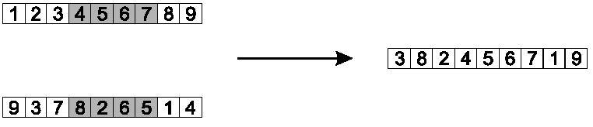
Order 1 crossover example
Copy randomly selected set from first parent
Copy rest from second parent in order 1,9,3,8,2

Slide 50
Partially Mapped Crossover (PMX)
Informal procedure for parents P1 and P2:
Choose random segment and copy it from P1
Starting from the first crossover point look for elements in that segment of P2 that have not been copied
For each of these i look in the offspring to see what element j has been copied in its place from P1
Place i into the position occupied j in P2, since we know that we will not be putting j there (as is already in offspring)
If the place occupied by j in P2 has already been filled in the offspring k, put i in the position occupied by k in P2
Having dealt with the elements from the crossover segment, the rest of the offspring can be filled from P2.
Second child is created analogously

Slide 51
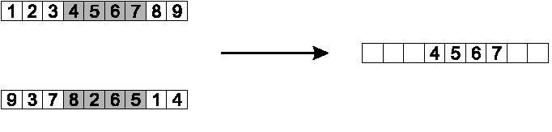
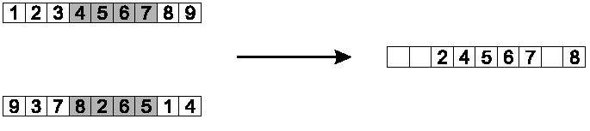
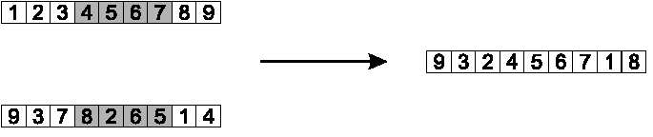
PMX example
Step 1
Step 2
Step 3

Slide 52
Cycle crossover
Basic idea:
Each allele comes from one parent together with its position.
Informal procedure:
1. Make a cycle of alleles from P1 in the following way.
(a) Start with the first allele of P1.
(b) Look at the allele at the same position in P2.
(c) Go to the position with the same allele in P1.
(d) Add this allele to the cycle.
(e) Repeat step b through d until you arrive at the first allele of P1.
2. Put the alleles of the cycle in the first child on the positions they have in the first parent.
3. Take next cycle from second parent

Slide 53
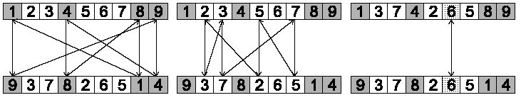
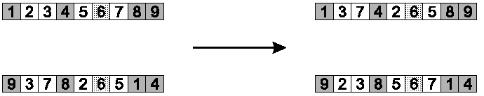
Cycle crossover example
Step 1: identify cycles
Step 2: copy alternate cycles into offspring

Slide 54
Multiparent recombination
Recall that we are not constricted by the practicalities of nature
Noting that mutation uses 1 parent, and “traditional” crossover 2, the extension to a>2 is natural to examine
Been around since 1960s, still rare but studies indicate useful
Three main types:
Based on allele frequencies, e.g., p-sexual voting generalising uniform crossover
Based on segmentation and recombination of the parents, e.g., diagonal crossover generalising n-point crossover
Based on numerical operations on real-valued alleles, e.g., center of mass crossover, generalising arithmetic recombination operators

Slide 55
Population Models
SGA uses a Generational model:
each individual survives for exactly one generation
the entire set of parents is replaced by the offspring
At the other end of the scale are Steady-State models:
one offspring is generated per generation,
one member of population replaced,
Generation Gap
the proportion of the population replaced
1.0 for GGA, 1/pop_size for SSGA

Slide 56
Fitness Based Competition
Selection can occur in two places:
Selection from current generation to take part in mating (parent selection)
Selection from parents + offspring to go into next generation (survivor selection)
Selection operators work on whole individual
i.e. they are representation-independent
Distinction between selection
operators: define selection probabilities
algorithms: define how probabilities are implemented

Slide 57
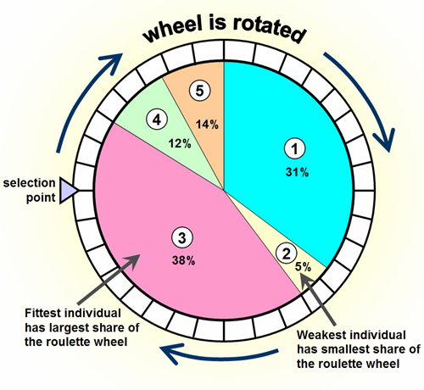
Implementation example: SGA
Expected number of copies of an individual i
E( n_{i} ) = μ • f(i)/ ⟨f⟩
(μ = pop.size, f(i) = fitness of i, ⟨f⟩ avg. fitness in pop.)
Roulette wheel algorithm:
Given a probability distribution, spin a 1-armed wheel n times to make n selections
No guarantees on actual value of n_{i}

Slide 58
Fitness-Proportionate Selection
Problems include
One highly fit member can rapidly take over if rest of population is much less fit: Premature Convergence
At end of runs when fitnesses are similar, lose selection pressure
Highly susceptible to function transposition
Scaling can fix last two problems
Windowing: f’(i) = f(i) - β ^{t}
where β is worst fitness in this (last n) generations
Sigma Scaling: f’(i) = max( f(i) – (⟨ f ⟩ - c • σ_{f} ), 0.0)
where c is a constant, usually 2.0

Slide 59
Selection Survival of the Strongest
Previous generation
0.93
0.51
0.72
0.31
0.12
0.64
Next generation
0.93
0.72
0.64

Slide 60
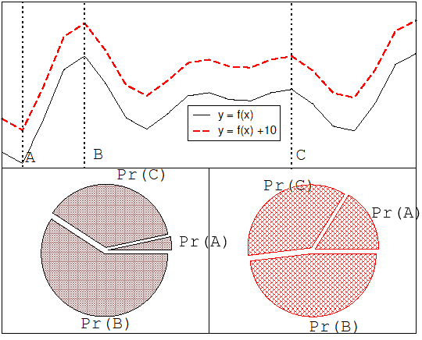
Function transposition for FPS

Slide 61
Rank – Based Selection
Attempt to remove problems of FPS by basing selection probabilities on relative rather than absolute fitness
Rank population according to fitness and then base selection probabilities on rank where fittest has rank μ and worst rank 1
This imposes a sorting overhead on the algorithm, but this is usually negligible compared to the fitness evaluation time

Slide 62
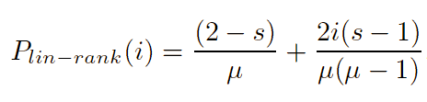
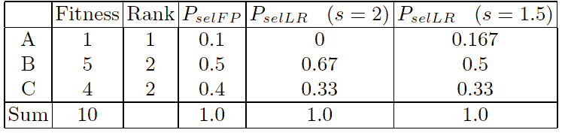
Linear Ranking
Parameterised by factor s: 1.0 < s ≤ 2.0
measures advantage of best individual
in GGA this is the number of children allotted to it
Simple 3 member example

Slide 63
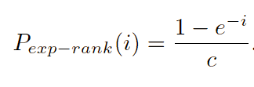
Exponential Ranking
Linear Ranking is limited to selection pressure
Exponential Ranking can allocate more than 2 copies to fittest individual
Normalise constant factor c according to population size

Slide 64
Tournament Selection
All methods above rely on global population statistics
Could be a bottleneck esp. on parallel machines
Relies on presence of external fitness function which might not exist: e.g. evolving game players
Informal Procedure:
Pick k members at random then select the best of these
Repeat to select more individuals
q=6
selection

Slide 65
Tournament Selection 2
Probability of selecting i will depend on:
Rank of i
Size of sample k
higher k increases selection pressure
Whether contestants are picked with replacement
Picking without replacement increases selection pressure
Whether fittest contestant always wins (deterministic) or this happens with probability p
For k = 2, time for fittest individual to take over population is the same as linear ranking with s = 2 • p

Slide 66
Tournament Selection

Slide 67
Survivor Selection
Most of methods above used for parent selection
Survivor selection can be divided into two approaches:
Age-Based Selection
e.g. SGA
In SSGA can implement as “delete-random” (not recommended) or as first-in-first-out (a.k.a. delete-oldest)
Fitness-Based Selection
Using one of the methods above or

Slide 68
Two Special Cases
Elitism
Widely used in both population models (GGA, SSGA)
Always keep at least one copy of the fittest solution so far
GENITOR: a.k.a. “delete-worst”
From Whitley’s original Steady-State algorithm (he also used linear ranking for parent selection)
Rapid takeover : use with large populations or “no duplicates” policy

Slide 69
Examples
Maxone
Travelling Salesperson
Diophantine Equation
Knapsack
Arithmetic

Slide 70
Example (selection1)
Next we apply fitness proportionate selection with the roulette wheel method:
Individual i will have a
probability to be chosen
We repeat the extraction as many times as the number of individuals we need to have the same parent population size (6 in our case)
1
2
Area is Proportional to fitness value
n
3
4

Slide 71
Example (selection2)
Suppose that, after performing selection, we get the following population:
s₁` = 1111010101 (s₁)
s₂` = 1110110101 (s₃)
s₃` = 1110111101 (s₅)
s₄` = 0111000101 (s₂)
s₅` = 0100010011 (s₄)
s₆` = 1110111101 (s₅)

Slide 72
Example (crossover1)
Next we mate strings for crossover. For each couple we decide according to crossover probability (for instance 0.6) whether to actually perform crossover or not
Suppose that we decide to actually perform crossover only for couples (s₁`, s₂`) and (s₅`, s₆`). For each couple, we randomly extract a crossover point, for instance 2 for the first and 5 for the second

Slide 73
Example (crossover2)
Before crossover:
s₁` = 1111010101
s₂` = 1110110101
s₅` = 0100010011
s₆` = 1110111101
After crossover:
s₁`` = 1110110101
s₂`` = 1111010101
s₅`` = 0100011101
s₆`` = 1110110011

Slide 74
Example (mutation1)
The final step is to apply random mutation: for each bit that we are to copy to the new population we allow a small probability of error (for instance 0.1)
Before applying mutation:
s₁`` = 1110110101
s₂`` = 1111010101
s₃`` = 1110111101
s₄`` = 0111000101
s₅`` = 0100011101
s₆`` = 1110110011

Slide 75
Example (mutation2)
After applying mutation:
s₁``` = 1110100101 f (s₁``` ) = 6
s₂``` = 1111110100 f (s₂``` ) = 7
s₃``` = 1110101111 f (s₃``` ) = 8
s₄``` = 0111000101 f (s₄``` ) = 5
s₅``` = 0100011101 f (s₅``` ) = 5
s₆``` = 1110110001 f (s₆``` ) = 6

Slide 76
Example (end)
In one generation, the total population fitness changed from 34 to 37, thus improved by ~9%
At this point, we go through the same process all over again, until a stopping criterion is met

Slide 77
Examples
Maxone
Travelling Salesperson
Diophantine Equation
Knapsack

Slide 78
Traveling Salesperson Problem
Find a tour of a given set of cities so that
each city is visited only once
the total distance traveled is minimized

Slide 79
Encoding
Represent every city with an integer .
Consider 6 Indian cities –
Mumbai, Nagpur , Calcutta, Delhi, Bangalore and Pune assign a number to each.
Mumbai 1
Nagpur 2
Calcutta 3
Delhi 4
Bangalore 5
Pune 6

Slide 80
Encoding
Thus a path would be represented as a sequence of integers from 1 to 6.
The path [1 2 3 4 5 6] represents a path from
Mumbai to Nagpur - Nagpur to Calcutta - Calcutta to Delhi - Delhi to Bangalore - Bangalore to Pune and Pune to Mumbai.
Mumbai 1
Nagpur 2
Calcutta 3
Delhi 4
Pune 6

Slide 81
Fitness Function
The fitness function will be the total cost of the tour represented by each chromosome.
This can be calculated as the sum of the distances traversed in each travel segment.
The Lesser The Sum, The Fitter The Solution Represented By That Chromosome.

Slide 82
Distance/Cost Matrix For TSP
 | 1 | 2 | 3 | 4 | 5 | 6
1 | 0 | 863 | 1987 | 1407 | 998 | 163
2 | 863 | 0 | 1124 | 1012 | 1049 | 620
3 | 1987 | 1124 | 0 | 1461 | 1881 | 1844
4 | 1407 | 1012 | 1461 | 0 | 2061 | 1437
5 | 998 | 1049 | 1881 | 2061 | 0 | 841
6 | 163 | 620 | 1844 | 1437 | 841 | 0

Slide 83
Fitness Function (contd.)
So, for a chromosome [4 1 3 2 5 6 ], the total cost of travel or fitness will be calculated as shown below
Fitness = 1407 + 1987 + 1124 + 1049 + 841
= 6408 kms.
Since our objective is to Minimize the distance, the lesser the total distance, the fitter the solution.

Slide 84
Initial Population for TSP
(5,3,4,6,2)
(2,4,6,3,5)
(4,3,6,5,2)
(2,3,4,6,5)
(4,3,6,2,5)
(3,4,5,2,6)
(3,5,4,6,2)
(4,5,3,6,2)
(5,4,2,3,6)
(4,6,3,2,5)
(3,4,2,6,5)
(3,6,5,1,4)

Slide 85
Select Parents
(5,3,4,6,2)
(2,4,6,3,5)
(4,3,6,5,2)
(2,3,4,6,5)
(4,3,6,2,5)
(3,4,5,2,6)
(3,5,4,6,2)
(4,5,3,6,2)
(5,4,2,3,6)
(4,6,3,2,5)
(3,4,2,6,5)
(3,6,5,1,4)
Try to pick the better ones.

Slide 86
Create Off-Spring – 1 point
(5,3,4,6,2)
(2,4,6,3,5)
(4,3,6,5,2)
(2,3,4,6,5)
(4,3,6,2,5)
(3,4,5,2,6)
(3,5,4,6,2)
(4,5,3,6,2)
(5,4,2,3,6)
(4,6,3,2,5)
(3,4,2,6,5)
(3,6,5,1,4)
(3,4,5,6,2)

Slide 87
Create More Offspring
(5,3,4,6,2)
(2,4,6,3,5)
(4,3,6,5,2)
(2,3,4,6,5)
(4,3,6,2,5)
(3,4,5,2,6)
(3,5,4,6,2)
(4,5,3,6,2)
(5,4,2,3,6)
(4,6,3,2,5)
(3,4,2,6,5)
(3,6,5,1,4)
(3,4,5,6,2)
(5,4,2,6,3)

Slide 88
Mutate
(5,3,4,6,2)
(2,4,6,3,5)
(4,3,6,5,2)
(2,3,4,6,5)
(4,3,6,2,5)
(3,4,5,2,6)
(3,5,4,6,2)
(4,5,3,6,2)
(5,4,2,3,6)
(4,6,3,2,5)
(3,4,2,6,5)
(3,6,5,1,4)
(3,4,5,6,2)
(5,4,2,6,3)

Slide 89
Mutate
(5,3,4,6,2)
(2,4,6,3,5)
(4,3,6,5,2)
(2,3,4,6,5)
(2,3,6,4,5)
(3,4,5,2,6)
(3,5,4,6,2)
(4,5,3,6,2)
(5,4,2,3,6)
(4,6,3,2,5)
(3,4,2,6,5)
(3,6,5,1,4)
(3,4,5,6,2)
(5,4,2,6,3)

Slide 90
Eliminate
(5,3,4,6,2)
(2,4,6,3,5)
(4,3,6,5,2)
(2,3,4,6,5)
(2,3,6,4,5)
(3,4,5,2,6)
(3,5,4,6,2)
(4,5,3,6,2)
(5,4,2,3,6)
(4,6,3,2,5)
(3,4,2,6,5)
(3,6,5,1,4)
(3,4,5,6,2)
(5,4,2,6,3)
Tend to kill off the worst ones.

Slide 91
Integrate
(5,3,4,6,2)
(2,4,6,3,5)
(5,4,2,6,3)
(3,4,5,6,2)
(2,3,6,4,5)
(3,4,5,2,6)
(3,5,4,6,2)
(4,5,3,6,2)
(5,4,2,3,6)
(4,6,3,2,5)
(3,4,2,6,5)
(3,6,5,1,4)

Slide 92
Restart
(5,3,4,6,2)
(2,4,6,3,5)
(5,4,2,6,3)
(3,4,5,6,2)
(2,3,6,4,5)
(3,4,5,2,6)
(3,5,4,6,2)
(4,5,3,6,2)
(5,4,2,3,6)
(4,6,3,2,5)
(3,4,2,6,5)
(3,6,5,1,4)

Slide 93
Examples
Maxone
Travelling Salesperson
Diophantine Equation
Knapsack

Slide 94
Diophantine Equation
Diophantine (only integer solutions) equation: a+2b+3c+4d=30, where a, b, c, d are positive integers.
Using a genetic algorithm to solve above equation.
why not just use a brute force method ?
Notes:
The architecture of GA systems allow for a solution to be reached quicker since "better" solutions have a better chance of surviving and procreating, as opposed to randomly throwing out solutions and seeing which ones work.

Slide 95
Solution
First choose 5 random initial solution sets, with constraints 1 =< a, b, c, d =< 30.
Chromosome | (a, b, c, d)
1 | (1,28,15,3)
2 | (14,9,2,4)
3 | (13,5,7,3)
4 | (23,8,16,19)
5 | (9,13,5,2)

Slide 96
Solution cont..
Then calculate the fitness values for above solution
Chromosome | Fitness Value
1 | |114-30|=84
2 | |54-30|=24
3 | |56-30|=26
4 | |163-30|=133
5 | |58-30|=28

Slide 97
Solution cont..
Calculate the likelihood.
Fitness values that are lower are closer to the desired answer.
Chromosome | Likelihood
1 | (1/84)/0.135266 = 8.80%
2 | (1/24)/0.135266 = 30.8%
3 | (1/26)/0.135266 = 28.4%
4 | (1/133)/0.135266 = 5.56%
5 | (1/28)/0.135266 = 26.4%

Slide 98
Solution cont..
Select parents according to likelihoods calculated above
Father | Mother
3 | 1
5 | 2
3 | 5
2 | 5
5 | 3

Slide 99
Solution cont..
The offspring of each of these parents contains the genetic information of both father and mother.
Father | Mother | Offspring
a₁ | b₁,c₁,d₁ | a₂ | b₂,c₂,d₂ | a₁,b₂,c₂,d₂ or a₂,b₁,c₁,d₁
a₁,b₁ | c₁,d₁ | a₂,b₂ | c₂,d₂ | a₁,b₁,c₂,d₂ or a₂,b₂,c₁,d₁
a₁,b₁,c₁ | d₁ | a₂,b₂,c₂ | d₂ | a₁,b₁,c₁,d₂ or a₂,b₂,c₂,d₁

Slide 100
Solution cont..
There are many ways in which parents can trade genetic information to create an offspring, crossing over is just one way.

Slide 101
Solution cont..
Simulated Crossovers from Parent Chromosomes
Father Chromosome | Mother Chromosome | Offspring Chromosome
(13 | 5,7,3) | (1 | 28,15,3) | (13,28,15,3)
(9,13 | 5,2) | (14,9 | 2,4) | (9,13,2,4)
(13,5,7 | 3) | (9,13,5 | 2) | (13,5,7,2)
(14 | 9,2,4) | (9 | 13,5,2) | (14,13,5,2)
(13,5 | 7, 3) | (9,13 | 5, 2) | (13,5,5,2)

Slide 102
Solution cont..
Again we calculate fitness values for new generation of offsprings.
Offspring Chromosome | Fitness Value
(13,28,15,3) | |126-30|=96
(9,13,2,4) | |57-30|=27
(13,5,7,2) | |57-30|=22
(14,13,5,2) | |63-30|=33
(13,5,5,2) | |46-30|=16

Slide 103
Solution cont..
The average fitness value for the offspring chromosomes were 38.8, while the average fitness value for the parent chromosomes were 59.4.
Progressing at this rate, one chromosome should eventually reach a fitness level of 0 eventually, that is when a solution is found.

Slide 104
Examples
Maxone
Travelling Salesperson
Diophantine Equation
Knapsack

Slide 105
Example: The Knapsack Problem
You are going on an overnight hike and have a number of items that you could take along. Each item has a weight (in pounds) and a benefit or value to you on the hike(for measurements sake let’s say, in US dollars), and you can take one of each item at most. There is a capacity limit on the weight you can carry (constraint). This problem only illustrates one constraint, but in reality there could be many constraints including volume, time, etc.

Slide 106
GA Example: The Knapsack Problem
Item: 1 2 3 4 5 6 7
Benefit: 5 8 3 2 7 9 4
Weight: 7 8 4 10 4 6 4
Knapsack holds a maximum of 22 pounds
Fill it to get the maximum benefit
Solutions take the form of a string of 1’s and 0’s
Solutions: Also known as strings of genes called Chromosomes
1. 0101010
2. 1100100
3. 0100111

Slide 107
Example: The Knapsack Problem
We represent a solution as a string of seven 1s and 0s and the fitness function as the total benefit, which is the sum of the gene values in a string solution times their representative benefit coefficient.
The method generates a set of random solutions (initial parents), uses total benefit as the fitness function and selects the parents randomly to create generations of offspring by crossover and mutation.

Slide 108
Knapsack Example
Typically, a string of 1s and 0s can represent a solution.
Possible solutions generated by the system using Reproduction, Crossover, or Mutations
1. 0101010
2. 1100100
3. 0100111

Slide 109
Knapsack Example Solution 1
Item | 1 | 2 | 3 | 4 | 5 | 6 | 7
Solution | 0 | 1 | 0 | 1 | 0 | 1 | 0
Benefit | 5 | 8 | 3 | 2 | 7 | 9 | 4
Weight | 7 | 8 | 4 | 10 | 4 | 6 | 4
Benefit 8 + 2 + 9 = 19
Weight 8 + 10 + 6 = 24

Slide 110
Knapsack Example Solution 2
Item | 1 | 2 | 3 | 4 | 5 | 6 | 7
Solution | 1 | 1 | 0 | 0 | 1 | 0 | 0
Benefit | 5 | 8 | 3 | 2 | 7 | 9 | 4
Weight | 7 | 8 | 4 | 10 | 4 | 6 | 4
Benefit 5 + 8 + 7 = 20
Weight 7 + 8 + 4 = 19

Slide 111
Knapsack Example Solution 3
Item | 1 | 2 | 3 | 4 | 5 | 6 | 7
Solution | 0 | 1 | 0 | 0 | 1 | 1 | 1
Benefit | 5 | 8 | 3 | 2 | 7 | 9 | 4
Weight | 7 | 8 | 4 | 10 | 4 | 6 | 4
Benefit 8 + 7 + 9 + 4 = 28
Weight 8 + 4 + 6 + 4 = 22

Slide 112
Knapsack Example
Solution 3 is clearly the best solution and has met our conditions, therefore, item number 2, 5, 6, and 7 will be taken on the hiking trip. We will be able to get the most benefit out of these items while still having weight equal to 22 pounds.
This is a simple example illustrating a genetic algorithm approach.

Slide 113
Knapsack Problem
To understand GA must work with the following problem:
(Knap Sack Problem)
Thief wants to steal gold store.
Thief has a bag(the bag can hold a specific weight).
Every piece of gold has a specific weight and price.
Thief wants to steal gold with high price but the weight must equal or less than the weight that bag can hold it.
If we gave every gold piece a specific number 1,2,3,…,n(suggest n=8 in this example).

Slide 114
1-Encoding (representation)(gene,chromosome)
Chromosome could be:
Bit strings (101101010100).
Real numbers (43.1,45.2,66.3,11.0).
Permutation of elements (E11 E3 E7 … E1 E15).
Integer Numbers (11,12,54,98,625,1).
Any data structures.
In knap sack problem can represent any solution as chromosome by using bit string of length 8.
Ex:- 1 1 0 1 0 0 0 1
8 7 6 5 4 3 2 1
1(gene):this piece taken, 0(gene):this piece untaken.

Slide 115
2-Initialize population
Implementers specify population size .
To initialize population create chromosomes randomly and store them in list of length the population size.
In our problem lets take population size 6 chromosomes.
We can initialize population a following:

Slide 116
3-Evaluation of population.
Giving every chromosome in population fitness value by using fitness function.
Fitness functions will differ according to the problem and encoding technique.
Fitness function returns a single numerical(fitness) which reflex the utility or the ability of the individual which that chromosome represents.
Fitness function can calculate : strength, weight, width, maximum load,cost,construction time or combination of all these.
Fitness value well be stored with chromosome.
chromosome
Fitness function
Fitness value

Slide 117
- In our example we will make fitness function as the sum of price of all gold pieces. -To complete our example must apply fitness function on all chromosomes.
Chromosome fitness value

Slide 118
4-Selection of new parents(reproduction)
Individuals are selected from population randomly or by using any selection method to improve the population itself.
Good individuals will probably be selected several times in a generation ,poor ones may not be at all.
Methods of selection
Random ,Best, Tournament, Roulette wheel, Truncation, Rank, Exponential, Boltzman, Steady state, Interactive and binary tournament selection.
In our example we will use Truncation selection with parameter 3.
search best 3 chromosomes and then select 6 chromosomes randomly from these three chromosomes and store them as new population to be used in the next step.

Slide 119
Old population
Search best 3 chromosomes
New population

Slide 120
5-Crossover
Crossover is performed with probability Pcross (crossover probability or crossover rate ) between two selected individuals, called parents, by exchanging parts of their genes to form two new individuals called offsprings.
The simplest method know as single point crossover.
Single point crossover take 2 individual and cut their chromosome strings at randomly chosen position, to produce 2 head segments and 2 tail segments .The tail segments are then swapped over to produce 2 new full length chromosomes.
Pcross (crossover probability or crossover rate ) is typically between 0.6 and 1.0
There is also Multi-Point, Uniform, Bit Simulated, Problem Centered and specialized crossover techniques.

Slide 121
we will do it just for first two parents.
Pcross=0.6
Select two parent(1,2)
Generate random number between 0.0-1.0(0.3)
0.3<=0.6(yes) apply crossover
generate random number between 1-8(3)
old 0 1 0 1 0 1 0 1 0 0 0 0 1 1 1 1
new 0 1 0 1 0 1 1 1 0 0 0 0 1 1 0 1 swap tails
Do this for each pair in population.

Slide 122
6-Mutation
Applied to each child individually after crossover .
It alters some of genes in chromosome with small probability .
Must specify Pmut(mutation probability that is relatively small) therefore a few number of chromosomes will be mutated.
In our example:
suppose Pmut =0.2
generate number between 0-1 (0.01)
0.01<=0.2(yes) apply mutation.
Generate number between 1-8(6)
0 1 0 1 0 1 0 1 => 0 1 1 1 0 1 0 1
Do this for each chromosome in population.

Slide 123
Termination Criteria
There exist three termination condition type:
1-Time:in seconds, in minutes and may be in hours according to the problem that you have it.
2-Number of generations: in hundreds, in thousands may be in millions according to the problem you have it.
3-convergence: when 95% of populations have the same fitness value we can say the convergence started to appear and the user can stop its genetic program to take the result.

Slide 124
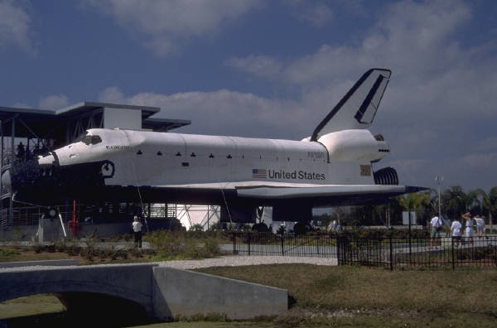
The Knapsack Problem
The knapsack problem, though simple, has many important applications including determining what items to take on a space ship mission.

Slide 125
Summary
Given an exponential problem to solve, ...
Encoding technique (gene, chromosome)
Initialization procedure (creation)
Evaluation function (environment)
Selection of parents (reproduction)
Genetic operators (mutation, recombination)
Parameter settings (practice and art)

